Slide 1
Week 5 Classroom Session

Slide 2
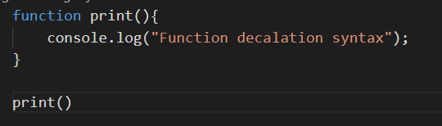
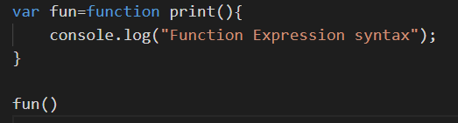
Functions in JS
Functions contain operations which can be used repeatedly by calling the function.
Functions can be defined and declared using two approaches-
using function declaration syntax
using function expression syntax
Function declaration syntax uses ‘function keyword’
Function expression syntax uses a variable referencing to a function defined using function declaration syntax.

Slide 3
IIFE in JS
IIFE stands for Immediately Invoked Function Expression.
We can restrict a function to be global and as well as to be referenced by a variable in JS.
These functions are called as soon as they are defined.
Ex- ( function (x,y){
console.log( x*y);
}
)(5,10);
IIFE can also return a value and that value can be stored in a variable.
Ex- var area= ( function (x,y){
console.log( x*y);
return x*y;
}
)(5,10);

Slide 4
Array in JS
Array is a special object in JS which can hold more than one value-
Ex- var array=[1,2,3,4,5,6]
Array object in Js offer a number of methods and properties-
length - Used to get array length (arr.length)
sort() - Used to sort the array lexicographically
push() - Used to insert an element in the end of array
pop() - Used to remove the element present in the end of array
shift() - Used to remove the first element of the array
slice(start,end) - Used to select the element between the given index of an array

Slide 5
Objects in JS
Objects in Js are variable too. But objects can contain many values and have values in key:value pairs.
Ex- var obj={name: ‘Demo’, count:1}
To have space between words of a key, key should be wrapped inside double quotes.
Ex- var obj={“first name”: ‘Demo’, count:1}
A object can have a key having a function as a value to it-
Ex- var obj = {name: ‘Demo’,
count:1,
updateCount: function(){
this.count++;}
}
To delete a key value pair(a property) we can use ‘delete obj[“keyname”]’ syntax.
Ex- for above defined obj object, delete obj[‘name’] will delete the name property of obj object.

Slide 6
String in JS
String can be created in JS using either double or single quote.
Ex- var s= “Demo” or var s= ‘Demo’
String object in Js offers a lot of handy methods to perform various operations on String in JS.
Some of the properties and methods of string object are-
length property | Used to get the count of characters in string object
substring(s,e) method | Used to get the substring from a string between the given indexes.
split(regex) method | Used to split a string into a number of substrings based on the provided regex.
replace(word) method | Used to replace the first match of the given word in the string and return a new string with replaced value.

Slide 7
Date and Number in JS
Date
Date object is used to deal with Dates in JS. One can create a date object using the syntax, var date=new Date()
By Default, JS will use the browser’s time zone and display date as a full text String.
Ex- Tue Feb 01 2022 22:29:56 GMT+0530 (India Standard Time)
Numbers
Number methods help you work with numbers in JS.
toFixed() of Number object returns a string, with the number written with a specified number of decimals:
Ex- let x = 9.656; x.toFixed(0); // output will be 10 (It will round to nearest number)

Slide 8
Number in JS
Number methods help you work with numbers in JS.
toFixed() of Number object returns a string, with the number written with a specified number of decimals:
Ex- let x = 9.656; x.toFixed(0); // output will be 10 (It will round to nearest number)
Some parsing methods-
parseInt() parses a string and returns a whole number. Spaces are allowed. Only the first number is returned:
parseFloat() parses a string and returns a number. Spaces are allowed. Only the first number is returned:
NaN is a JavaScript reserved word indicating that a number is not a legal number. Ex- let x=Number.NaN
To check a Number is NaN or not use isNaN(variable) method.

Slide 9
Math Object in JS
The JavaScript Math object allows you to perform mathematical tasks on numbers.
Math objects offer a number of properties and methods-
Math.ceil(x) returns x rounded up to its nearest integer
Math.round(x) returns x rounded up to its nearest integer
Math.floor(x) returns x rounded down to its nearest integer
Math.pow(x, y) returns the value of x to the power of y
Math.sqrt(x) returns the square root of x
Math.abs(x) returns the absolute (positive) value of x
Math.random() returns a random number between 0 (inclusive), and 1 (exclusive)
Math.min() and Math.max() can be used to find the lowest or highest value in a list of arguments

Slide 10
innerHTML and setTimeout() in JS
InnerHTML
The innerHTML property refers the content of a html tag.
Below line will change the HTML content of above <p> tag with id “paragraph”
document.getElementById("paragraph").innerHTML = "Content Changed";
setTimeout()
The setTimeout() method calls a function after a number of milliseconds.
It will take two parameters. they are one function and delay execute function time in milliseconds
Ex-
setTimeout(fun(),1000)
function fun(){ // this function will be executed after 1000 milliseconds
console.log(“Called”)
}
The above line will call fun() method after 1 sec (1000 milliseconds).

Slide 11
Problem Statement 1
Create a meeting scheduler where one can request for meeting and the receiver can accept or reject the meeting.
The receiver will have couple of free hours in a day. When the meeting request is sent, the request will be added in pending meeting list.
The receiver will accept/reject the request.
when the request is accepted, print a message saying that the meeting is approved and add it to approved meeting list. Show the free hour list also.
when the request is declined, print a message saying that the meeting is declined and add it to declined meeting list.
create all the necessary functions where Virat Kohli is the receiver.

Slide 12
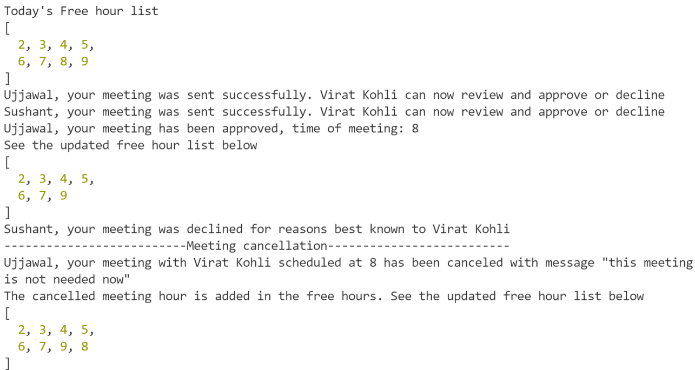
Sample Output

Slide 13
Problem Statement 2
Create an application where
When clicked on an Image, Start the timer.
When 10 is remaining, change the timer color to red and print Hurry UP below.
After the time is over, Raise alert on the screen saying “Time out”
After you click on Okay, Print “Time Up” on the screen and hide the timer.
Use HTML CSS and Javascript to create the application.

Slide 14
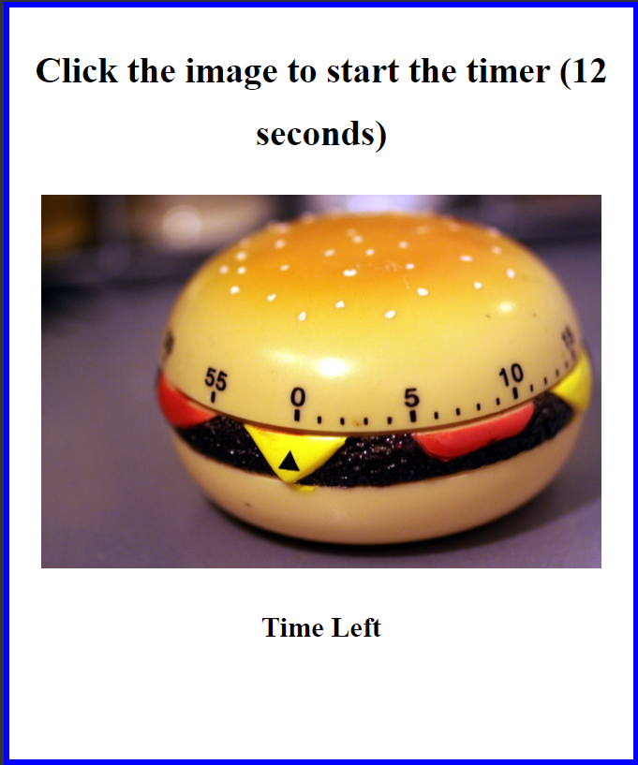
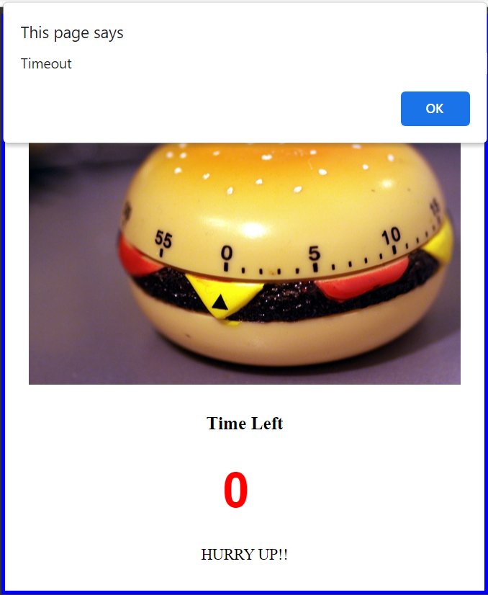
Sample Output

Slide 15
Problem Statement 3
create html page which can perform the following operations
Q1
Use 2 input tags two take two numbers from user
use list to select the operator
when clicked on “=” button, perform the operation and print the output in the web page
Q2
Take the entire expression from the use in single input
when clicked on “=” button, perform the operation and print the output in the web page
If the expression is incorrect, then raise an alert message saying “Incorrect Input”

Slide 16
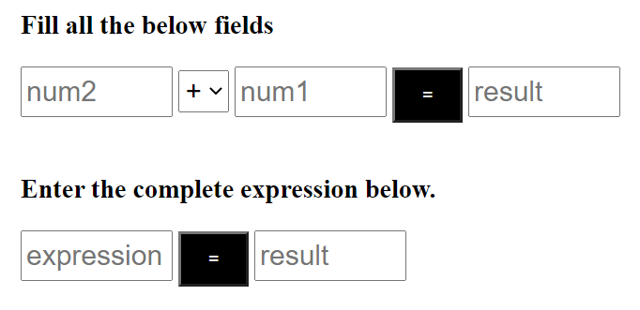
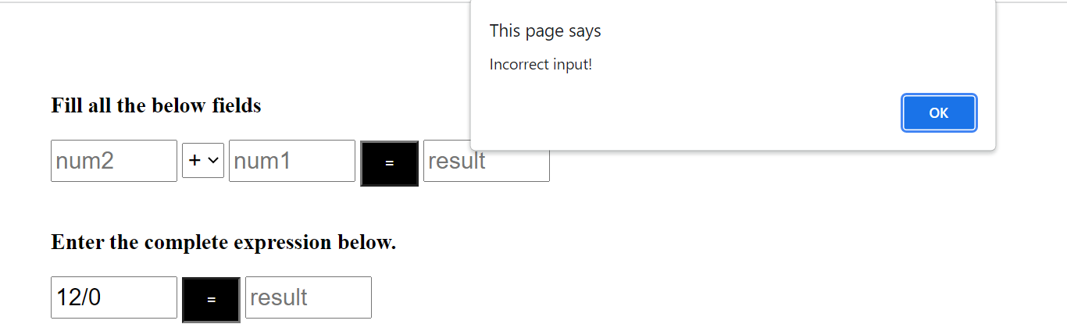
Sample Output

Slide 17
Thank You

